Slide 1
BRAIN DRAIN

Slide 2
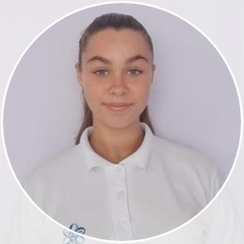
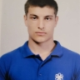
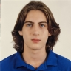
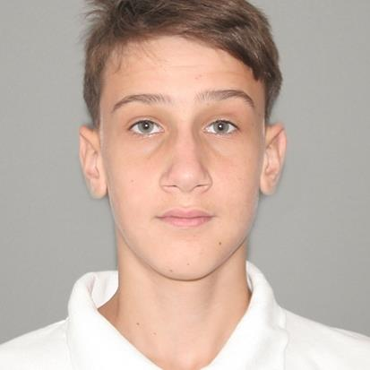
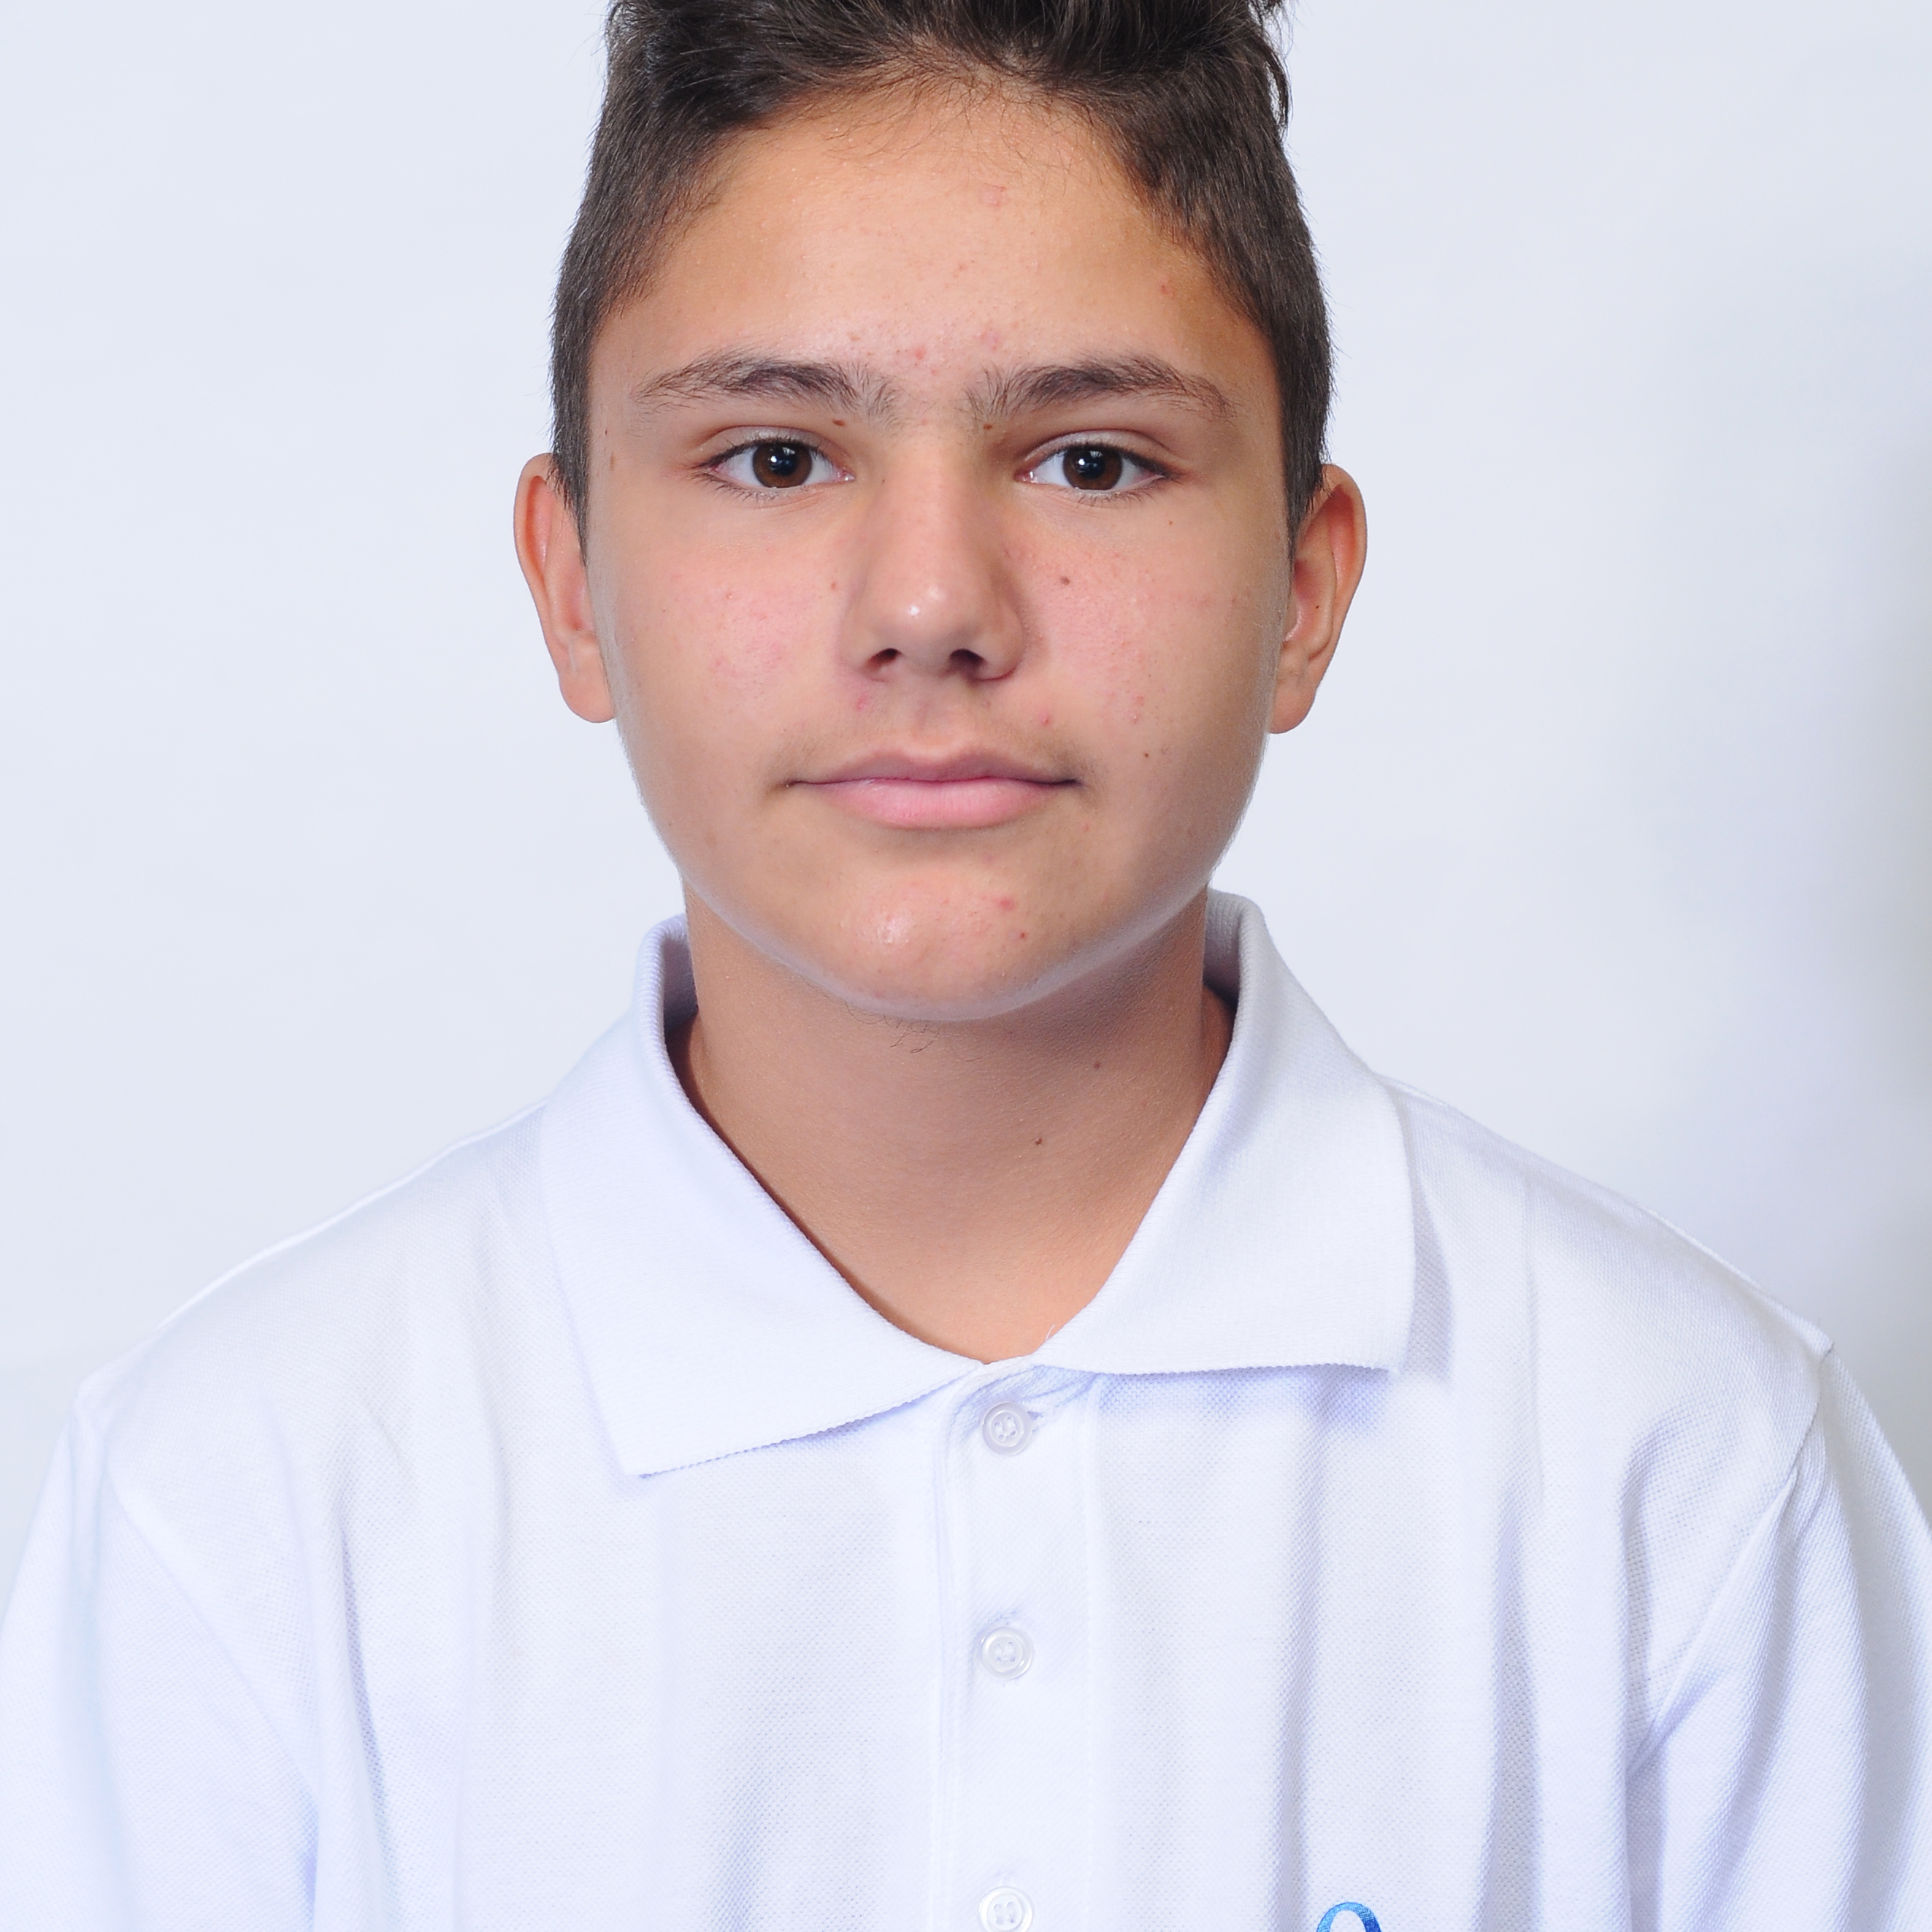
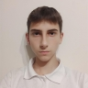
OUR TEAM
Zhaklin Yankova
Ivaylo Dandarinov
Scrum Trainer
Back-End Developer
Martin Velkov
Aleksandar Ivanov
Back-End Developer
QA Engineer
Stiliyan Dimitrov
Ivan Dimov
Back-End Developer
Back-End Developer

Slide 3
THE IDEA
We have created an app that teaches basic math, chemistry and English. But our idea is much more fun than what you think, because we have combined these subjects with fun mini-games such as Super Mario, drag and drop experiments, and maze games.

Slide 4
STAGES OF DEVELOPMENT
1st WEEK
2nd WEEK
3rd WEEK
4th WEEK
ORGANISATION
DESIGN
CODE
DOCUMENTS
Creating logo and discussing ideas about the game
Making the design
and implementing our ideas through code
Developing the code
Creating the documentation and presentation

Slide 5










USED TECHNOLOGIES
EXCEL
POWER POINT
WORD
VISUAL STUDIO
C++
RAYLIB
PISKEL
CANVA
GITHUB
TEAMS

Slide 6
THANK YOU FOR THE ATTENTION
Tres cosas que he aprendido
Dos cosas que debo mejorar
Una pregunta que quieras consultar
LET’S MOVE TO THE
DEMONSTRATION!

